Slide 1
Netflix & Blockbusters Streaming Services’ Disparate Impact on Box-Office Revenues

Slide 2
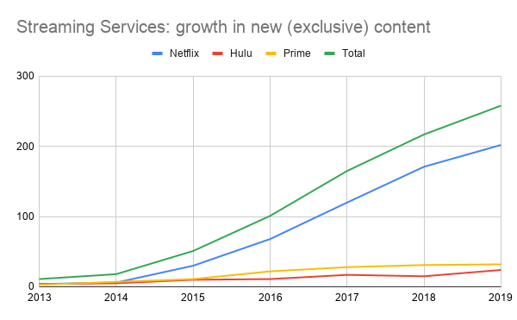
Streaming Services: a Rise in Original Content
2015

Slide 3
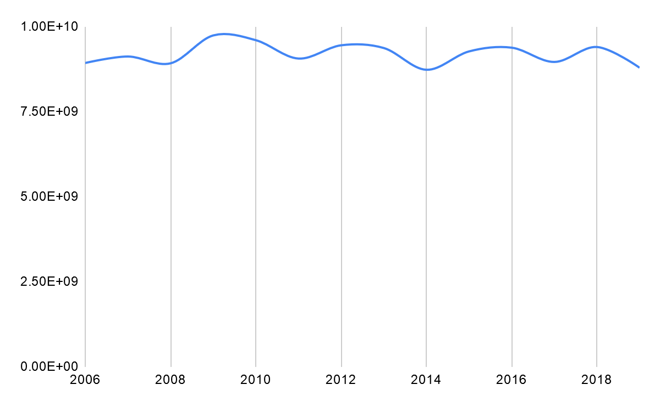
Research Question
Does Netflix originals cannibalize revenues at the box office?

Slide 4
Ideal Strategy:
Counterfactual world without streaming.
Alternative :
Simulate counterfactual ?
Data on streaming consumption unavailable.

Slide 5
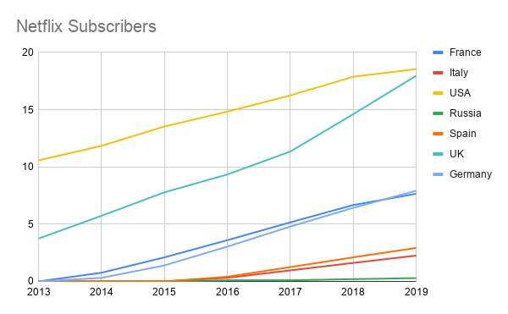
Europe as a reference group
USA and UK have relatively high number of subscribers in the period of study. The other countries have low Netflix coverage; the increase is more recent.
Notes:
Subscriptions expressed as percentage of population. In all the countries, Netflix is the market leader among streaming services.
Euro* includes countries France, Germany, Spain, Russia, Poland and Italy.

Slide 6
Empirical Strategy: Compare the B.O. generated in the U.S. (treated) to the B.O. in countries Europe (control). Identifying Assumption: If the slopes of the outcome variable are same prior to 2015-16, for European countries and the US, the post change can be attributed to availability of streaming in the U.S.

Slide 7
Data
B.O. of all movies released between April 2006 and March 2019
in countries:
Treat : United States (United Kingdom*)
Control: France, Germany, Spain, Italy, Russia and Poland
Data Processing:
Adjust B.O. to ‘05 dollars.
Period (t_{k})
t₁ - Apr 06 – Mar 07
t₂ – Oct 07 – Mar 08
.
.
t_{n} – Oct 18 – Mar 19
Notes:
We do not include United Kingdom in the analysis. Including does not qualitatively change the

Slide 8
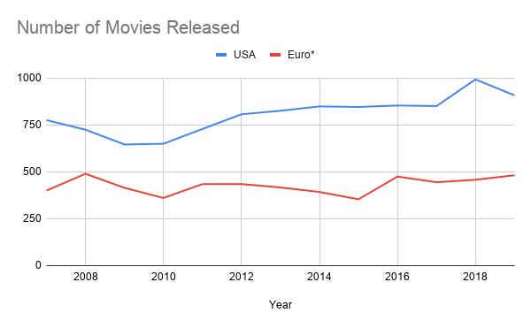
Trends at the Box Office: Increase in number of movies (US)

Slide 9
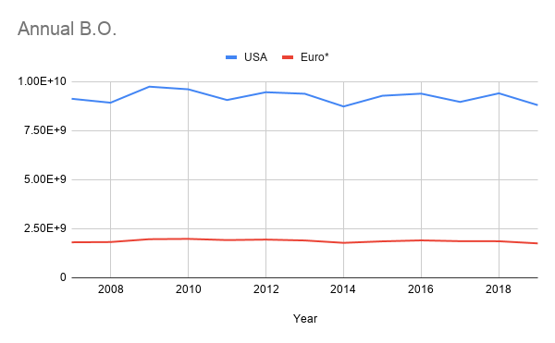
Gross B.O.; US vs Europe (adjusted)
All revenue figures are reported in ‘05 Dollars

Slide 10
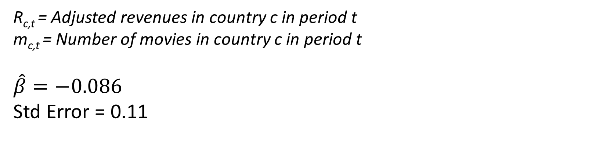
DiD to detect adverse effects
$$\log\left(R_{c,t}\right)=α+λ_{t}+γ_{c}+β_{t}∗1\left(c=USA,t>2014\right)+m_{c,t}+ ϵ$$
R_{c,t} = Adjusted revenues in country c in period t
m_{c,t} = Number of movies in country c in period t
$$\hat{β}=−0.086$$
Std Error = 0.11
Cannot precisely detect any adverse effect on box office revenues.

Slide 11
Disparate Impact ?
Tail movies → more likely to be impacted as streaming originals are closer substitutes.
Top movies (blockbusters) → action-adventure movies with star casts and large budgets; less likely to be impacted by streaming services’ original programs.

Slide 12
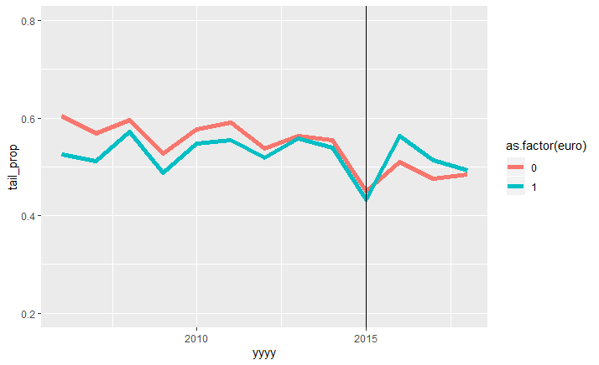
Proportion of B.O. from tail movies

Slide 13
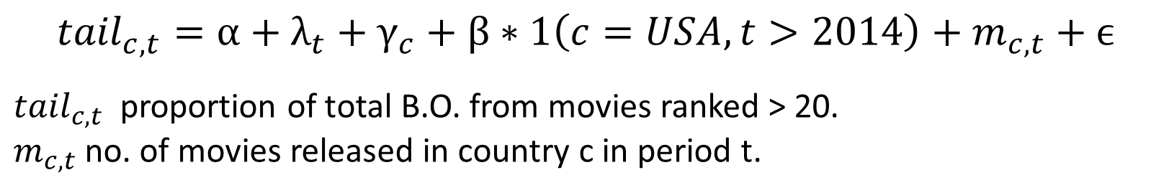
DiD Estimate
$${tail}_{c,t}=α+λ_{t}+γ_{c}+β∗1\left(c=USA,t>2014\right)+m_{c,t}+ϵ$$
${tail}_{c,t}$ proportion of total B.O. from movies ranked > 20.
$m_{c,t}$ no. of movies released in country c in period t.

Slide 14
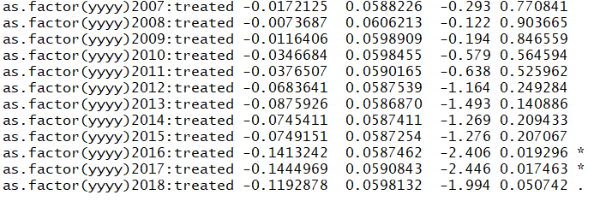
Pre-treatment trends
$${tail}_{c,t}=α+λ_{t}+γ_{c}+β_{t}∗1\left(c=USA\right)+m_{c,t}+ ϵ$$

Slide 15
Does availability of streaming service impact top movies (blockbusters) ?

Slide 16
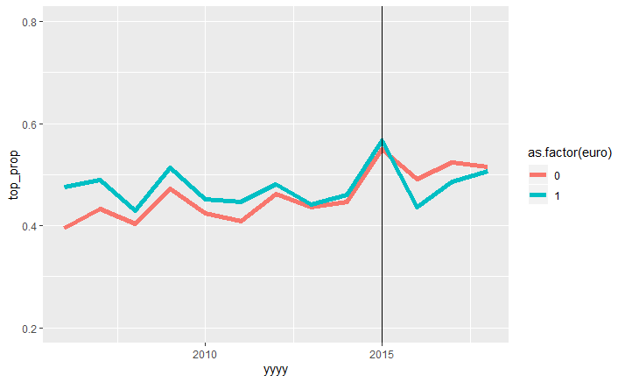
B.O. Proportion Top Movies

Slide 17
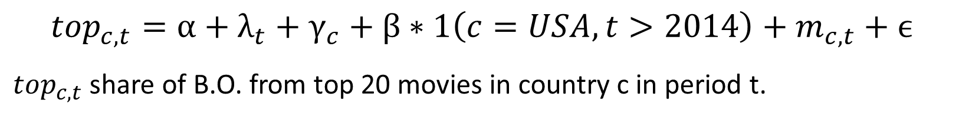
B.O. Share of Top Movies
$${top}_{c,t}=α+λ_{t}+γ_{c}+β∗1\left(c=USA,t>2014\right)+m_{c,t}+ϵ$$
${top}_{c,t}$ share of B.O. from top 20 movies in country c in period t.

Slide 18
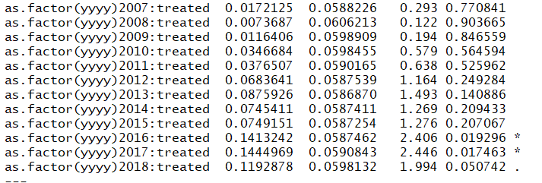
Pre-treatment trends
$${top}_{c,t}=α+λ_{t}+γ_{c}+β_{t}∗1\left(c=USA\right)+m_{c,t}+ ϵ$$

Slide 19
To Do
More flexible DiD; where treatment is Netflix availability.

Slide 20
Challenges
Attributing the change in US compared to Europe to streaming.
Originals vs availability of streaming.

Slide 21
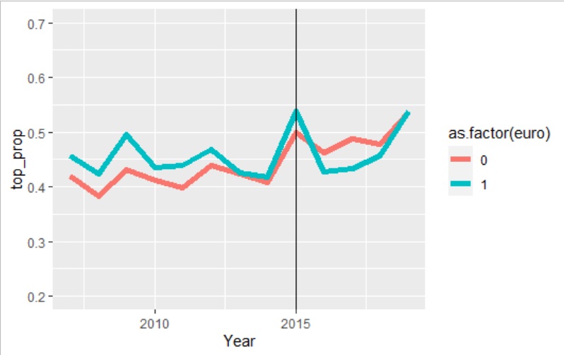
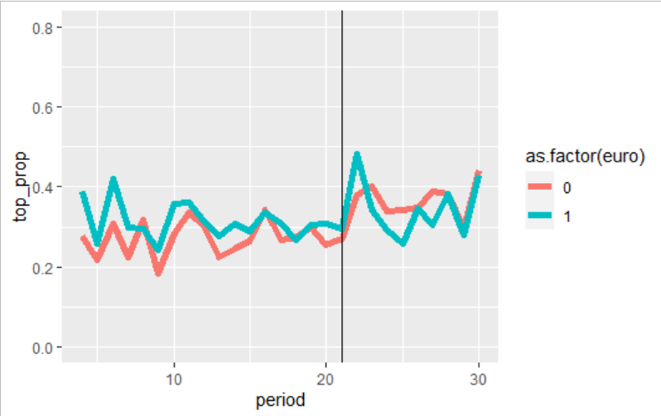

Slide 22
Data
B.O. of all movies released between April 2007 and September 2019
in countries:
Treat : United States (United Kingdom*)
Control: France, Germany, Spain, Italy, Russia and Poland
Data Processing:
Adjust B.O. to ‘05 dollars.
Period (t_{k})
t₁ - Apr 07 – Sep 07
t₂ – Oct 07 – Mar 08
.
.
t_{n} – Apr 19 – Sep 19
Notes:
We do not include United Kingdom in the analysis. Including does not qualitatively change the

Slide 23
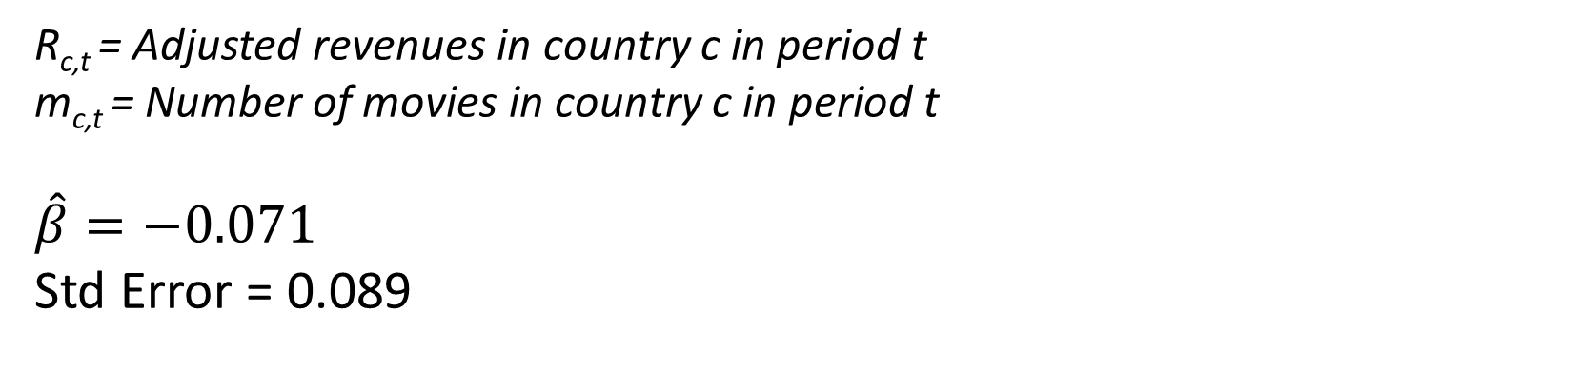
DiD to detect adverse effects
$$\log\left(R_{c,t}\right)=α+λ_{t}+γ_{c}+β_{t}∗1\left(c=USA,t>2014\right)+m_{c,t}+ ϵ$$
R_{c,t} = Adjusted revenues in country c in period t
m_{c,t} = Number of movies in country c in period t
$$\hat{β}=−0.071$$
Std Error = 0.089
Cannot precisely detect any adverse effect on box office revenues.

Slide 24
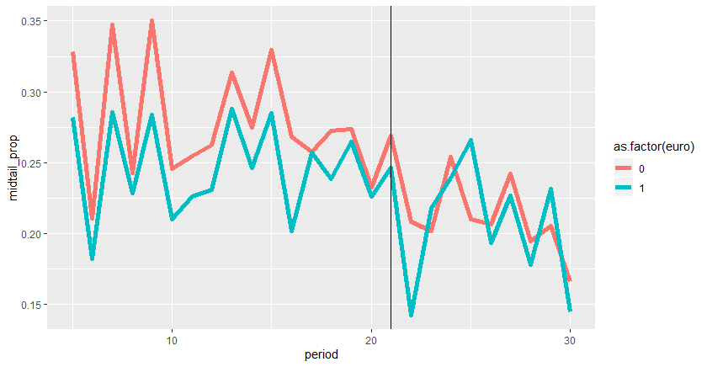
Proportion of B.O. from mid-tail movies

Slide 25
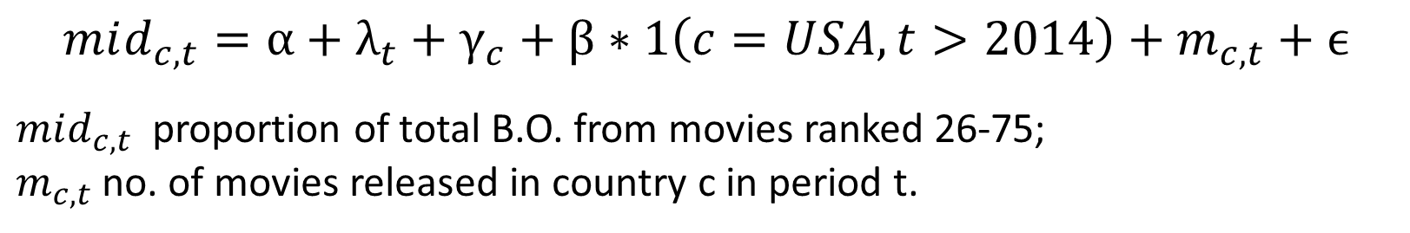
DiD Estimate
$$mid_{c,t}=α+λ_{t}+γ_{c}+β∗1\left(c=USA,t>2014\right)+m_{c,t}+ϵ$$
$mid_{c,t}$ proportion of total B.O. from movies ranked 26-75;
$m_{c,t}$ no. of movies released in country c in period t.

Slide 26
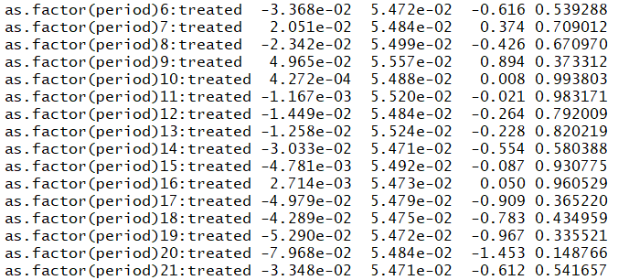
Pre-treatment trends
$$mid_{c,t}=α+λ_{t}+γ_{c}+β_{t}∗1\left(c=USA\right)+m_{c,t}+ ϵ$$

Slide 27
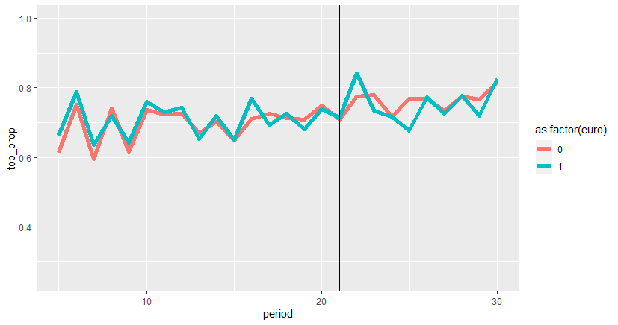
DiD: Top

Slide 28
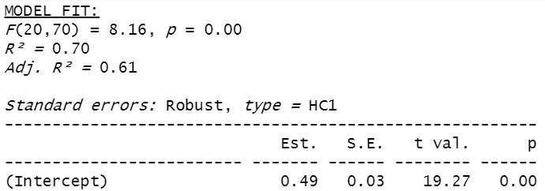
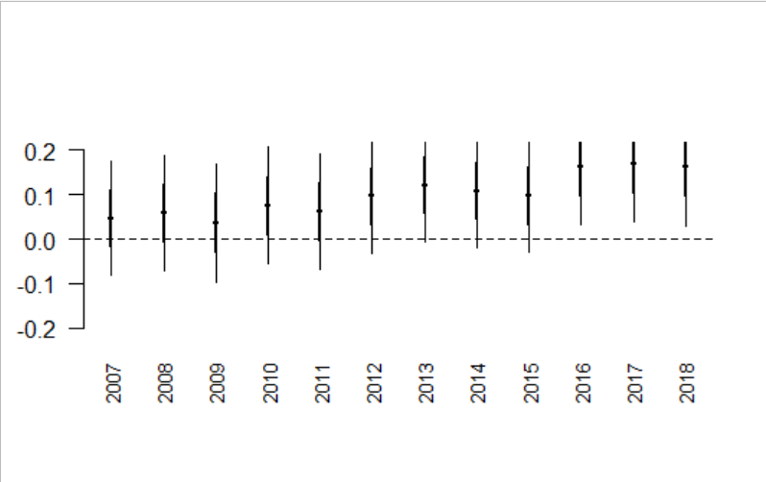
# Country fixed effects, Year fixed effects included.

Slide 29
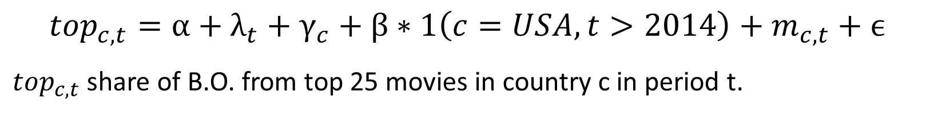
B.O. Share of Top Movies
$${top}_{c,t}=α+λ_{t}+γ_{c}+β∗1\left(c=USA,t>2014\right)+m_{c,t}+ϵ$$
${top}_{c,t}$ share of B.O. from top 25 movies in country c in period t.

Slide 30
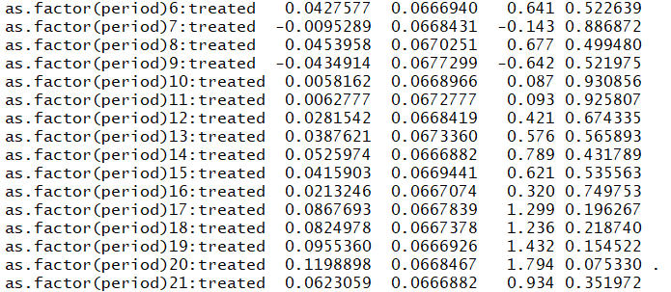
Pre-treatment trends
$${top}_{c,t}=α+λ_{t}+γ_{c}+β_{t}∗1\left(c=USA\right)+m_{c,t}+ ϵ$$

Slide 31
RT presentation

Slide 32
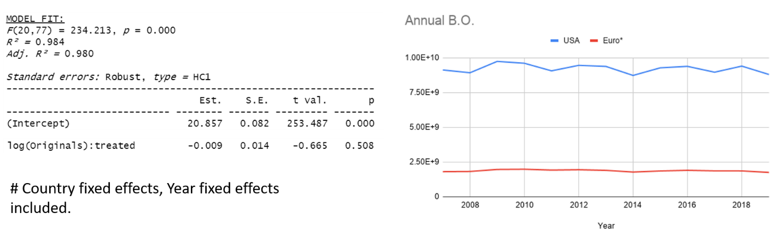
Effect on Overall BO
$$\log\left(R_{c,t}\right)=λ_{t}+γ_{c}+β∗1\left(treated;c=USA\right)∗log\left(originals_{t}\right)+ ϵ ,$$

Slide 33
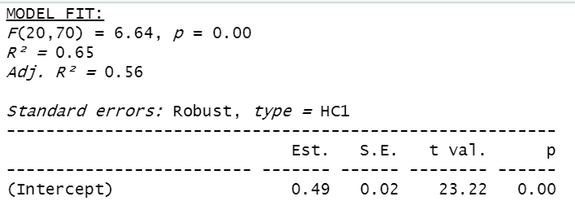
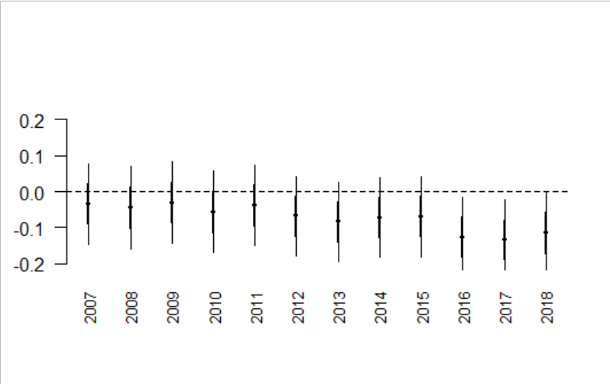
Effect on non- Blockbusters
$$\left({T_share}_{c,t}\right)=λ_{t}+γ_{c}+β∗1\left(treated;c=USA\right)∗log\left(originals_{t}\right)+ ϵ ,$$
# Country fixed effects, Year fixed effects included.

Slide 34
Trends at the Box Office: Increase in number of movies (US)

Slide 35
Data
Country | Average | SD
France | 364 | 103
Germany | 267 | 84.7
Italy | 315 | 43.5
Poland | 166 | 27.7
Russia | 330 | 101
Spain | 364 | 49
United Kingdom | 498 | 156
USA | 658 | 88.3

Slide 36
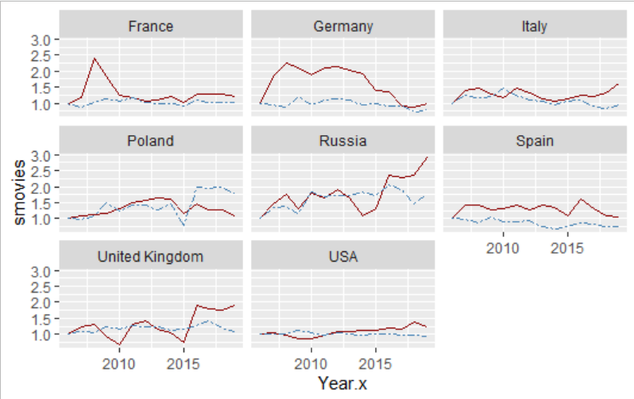

Slide 37
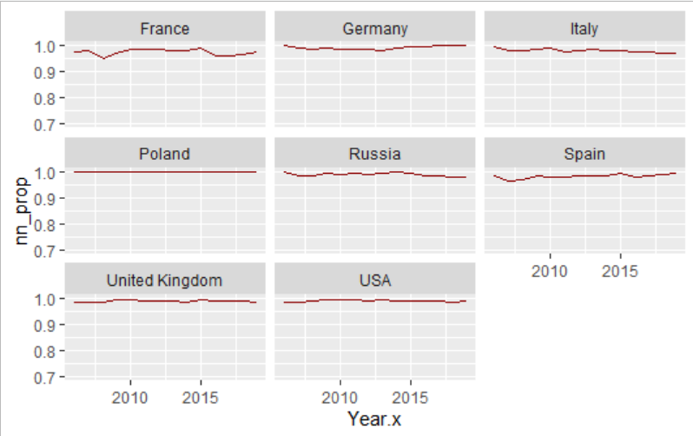
Top 200 movies BO Proportion

Slide 38
Are results driven by changes in supply ? Supply decisions: Genre, Budget

Slide 39
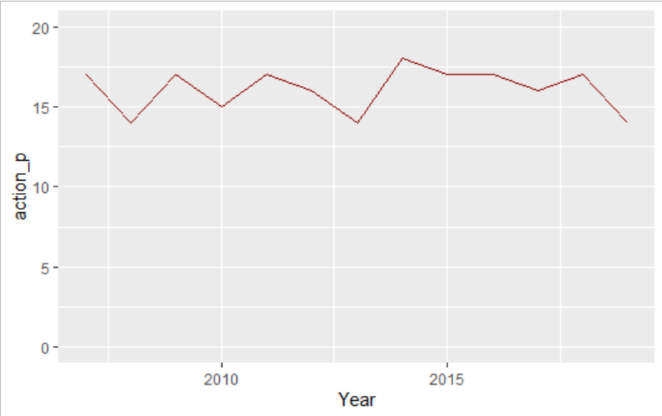
Genre Composition of Blockbusters have not changed in the period considered here 2007-19.

Slide 40
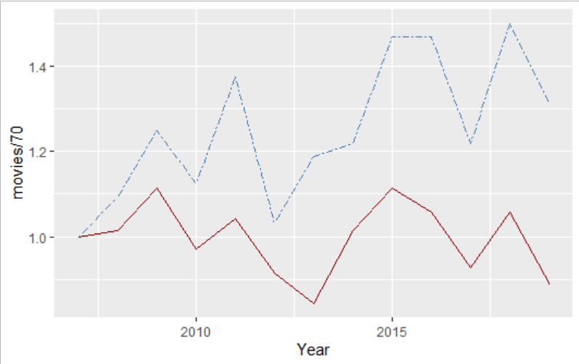
Genre Composition of Major Studios (Big 5):
Shift to Action/Adventure (blue)
Action, Adventure, Fantasy, Sci-Fi
No data on budgets !

Slide 41
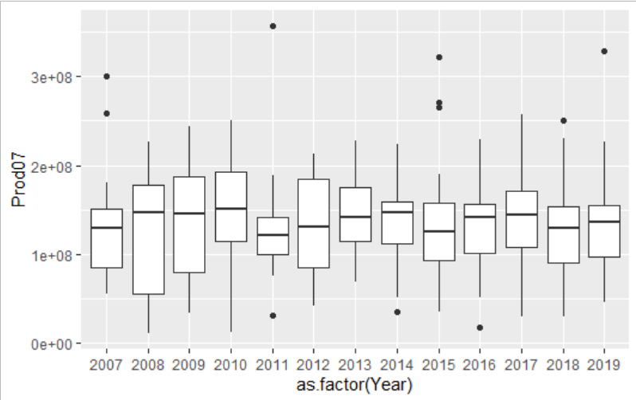
Production Budgets of Top 20 movies

Slide 42

Is there a decline in the share of revenues from non blockbusters in USA but not Europe for major studios ?

Slide 44
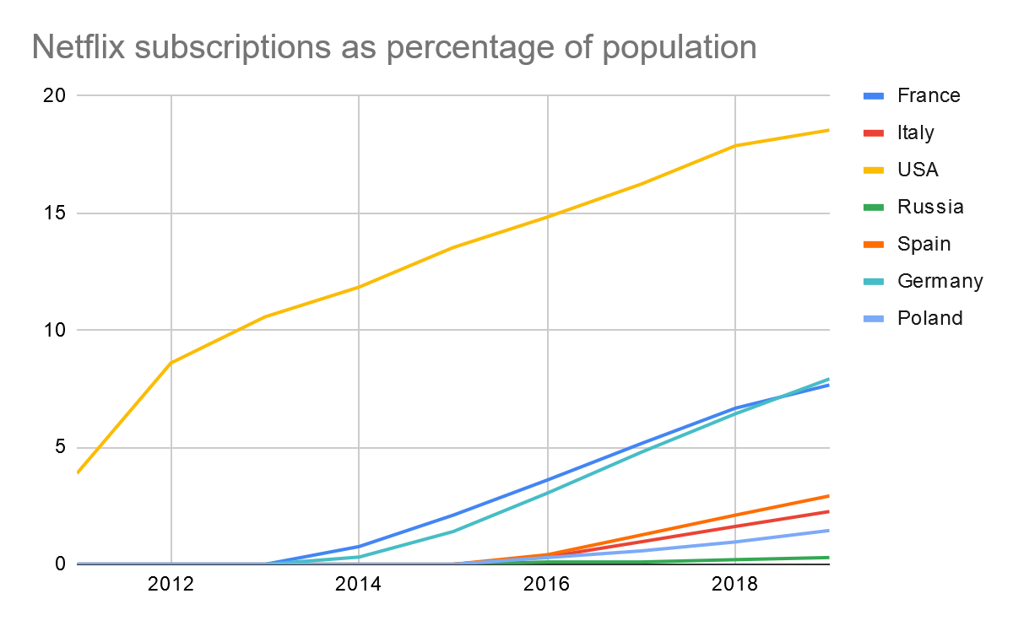

Slide 45
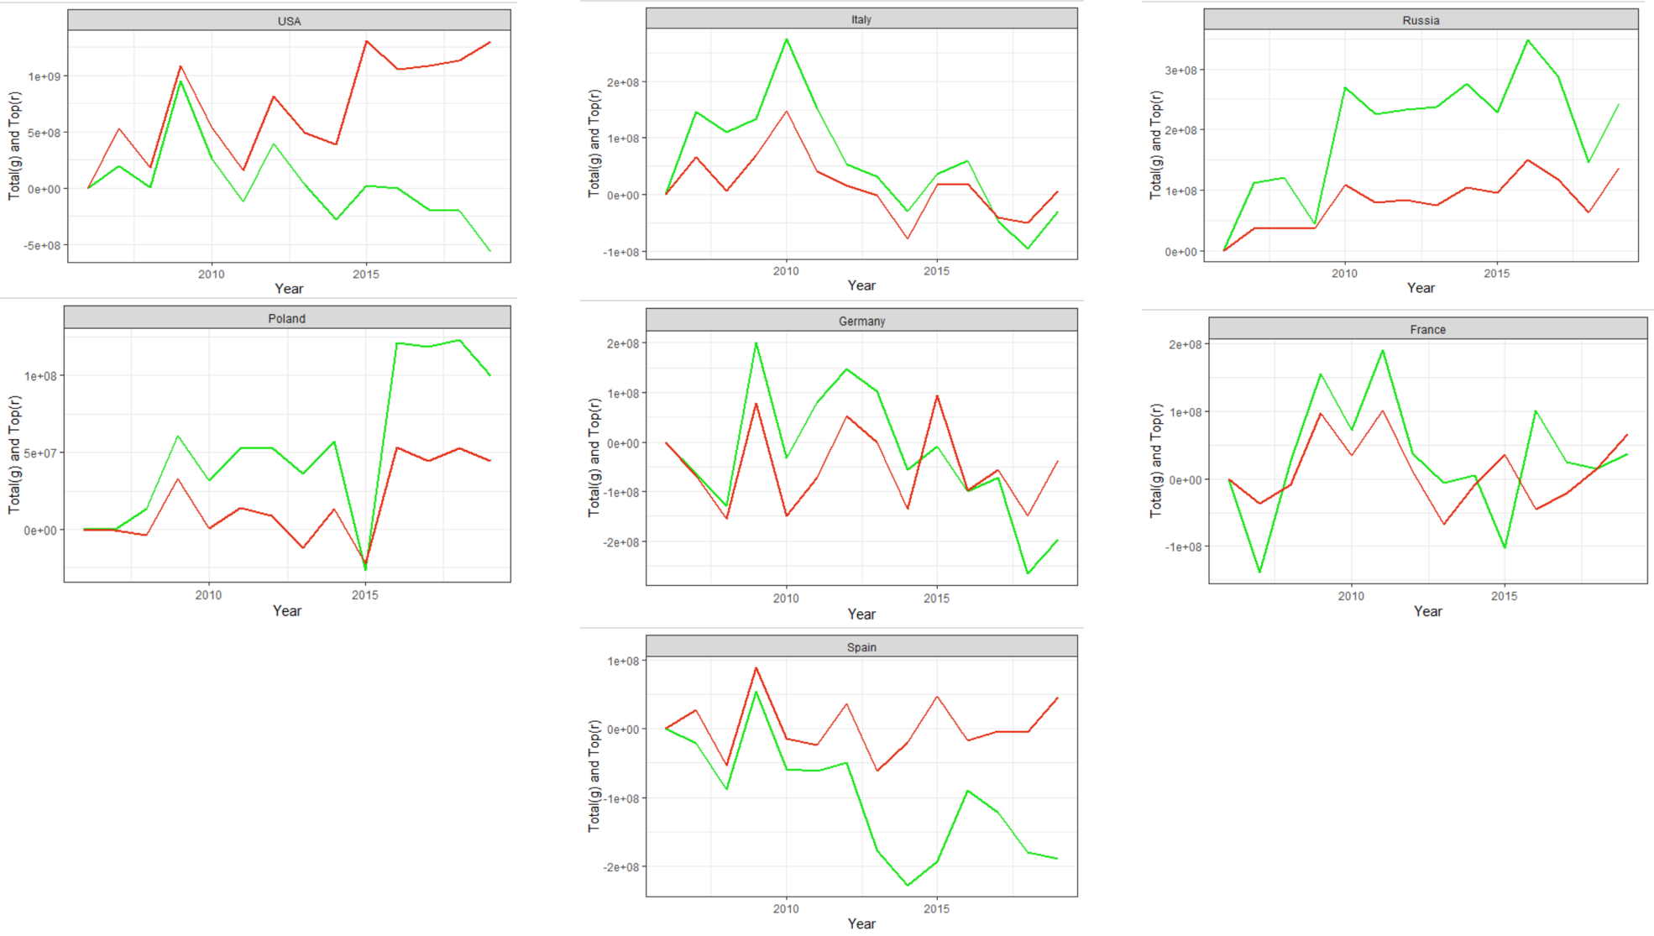

Slide 46
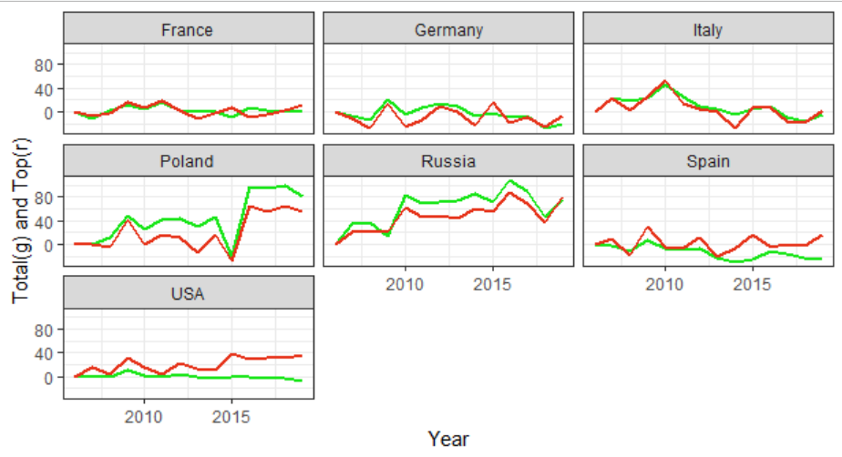

Slide 47
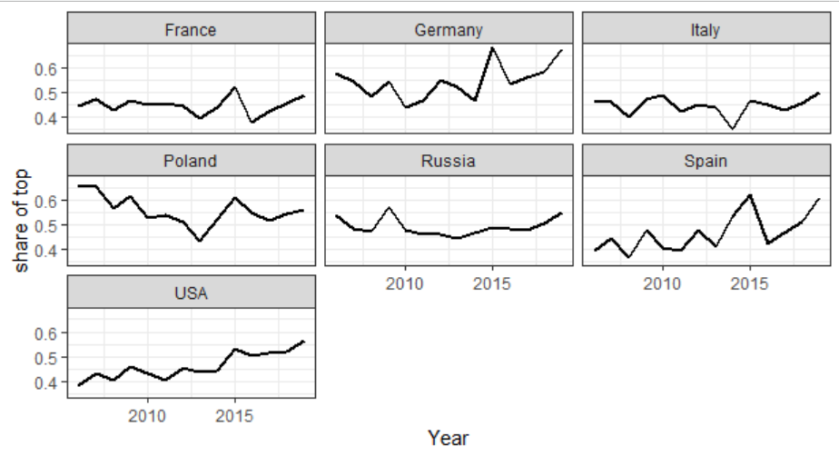

Slide 48
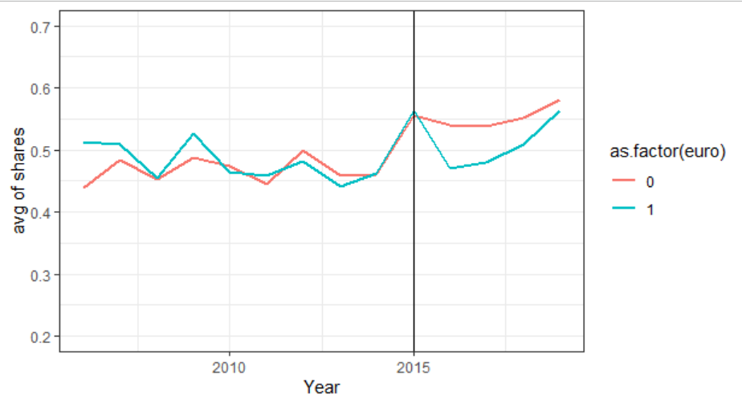

Slide 50
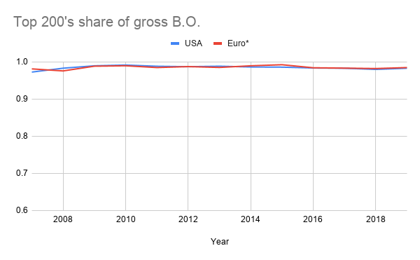
Trends at Box office: Long tail

